Slide 1
Cluster Analysis
Alone we can do so little, together we can do so much

Slide 2
Cluster Analysis
Introduction
Pre-requisite concepts
K-Means Clustering
Pros and Cons of K-means

Slide 3
Introduction

Slide 4
Cluster Analysis
“Cluster Analysis is a multivariate statistical technique that groups observations on the basis of some of their features or variables they are described by.”
In common terms,
Observations in a dataset can be divided into different groups and sometimes this is very useful.
It is a very useful technique for exploring an identifying patterns in the data.
Let’s see an example

Slide 5
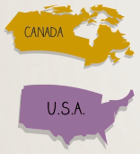


Cluster Analysis
Example:
Lets say we have 6 countries: USA, Canada, UK, Germany, France, Australia
Imagine we have now performed this technique called cluster analysis:
We got 3 groups or clusters.
Here, in these clusters, the countries are grouped by geographic proximity.
US & Canada – North American Countries
Germany & UK & France – European Countries
Australia – Oceania Country

Slide 6
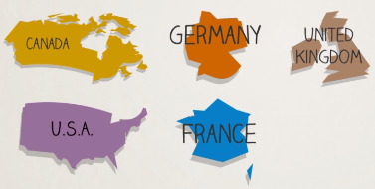

Cluster Analysis
Example:
Lets take the same data, now what if we cluster them in 2 clusters.
We get:
Here we can say the countries are clusters according to the hemisphere
Northern Hemisphere – Canada, USA, Germany, France, UK
Southern Hemisphere – Australia
Clustering is easy, isn’t it ?

Slide 7


Cluster Analysis
Wait a minute…
Lets take the same data, can also be clustered into two groups as:
Here we can say the countries are clusters according to the language:
English as Official Language – Canada, UK, USA, Australia
English not Official Language – France, Germany
Well in Canada both French and English are official language.

Slide 8
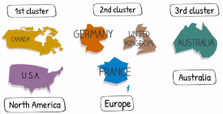
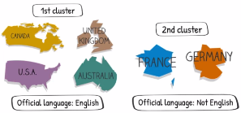
Cluster Analysis
Wait a minute…
We saw we can divide the data into cluster of two in two ways or probably more.
In our case, both the results are perfectly logical.

Slide 9
Cluster Analysis
Wait a minute…
Cluster Analysis is extremely intuitive but definitely tricky.
We can group the datasets in required number of clusters in lot many different ways.
Hence we should be very clear about our goal in cluster analysis

Slide 10
Cluster Analysis - Goal
Goal of Cluster Analysis
The goal of cluster analysis / clustering is:
To maximize the similarity of observations within a cluster
To maximize the dissimilarity between clusters

Slide 11
Cluster Analysis – Some Applications
Some Examples of cluster analysis are:
Market Segmentation
Image Segmentation

Slide 12
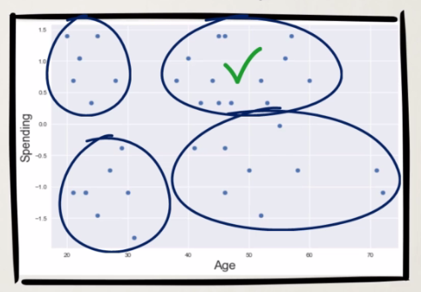
Cluster Analysis – Some Applications
Market Segmentation
Suppose you are appointed as a Data Scientist to a company whose marketing campaigns have been disastrous for quite a while now.
The firm gave you all the data they have gathered and ask you to create the next marketing campaign.
You have no idea who buys the product, so you decided to put some visualizations.

Slide 13
Pre-Requisite Concepts

Slide 14
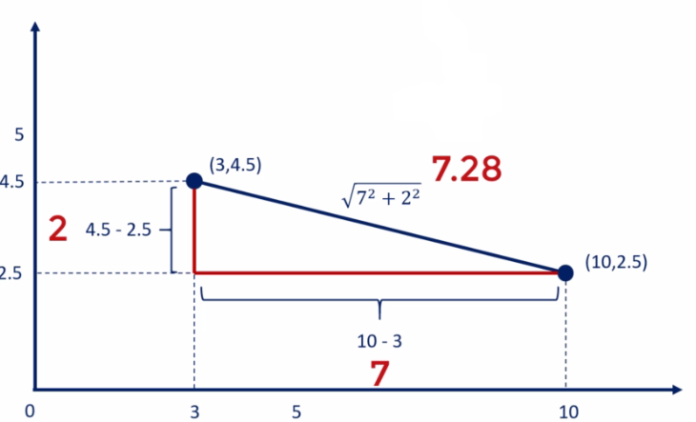
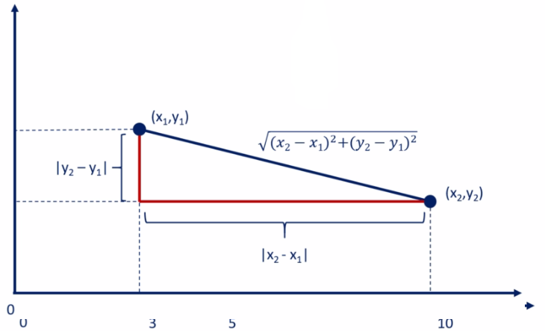
Pre-Requisite Concepts
Some Pre-requisite concepts:
Distance between points
Centroid
Lets see How to find Distance (Euclidean Distance)

Slide 15
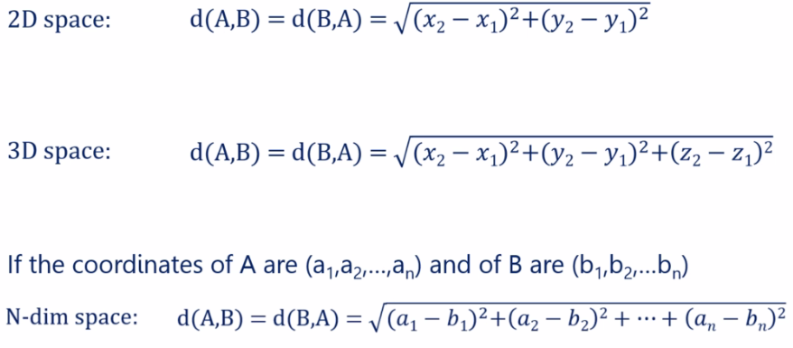
Pre-Requisite Concepts
Some Pre-requisite concepts:
Distance between points
Centroid
Lets see How to find Distance (Euclidean Distance)s

Slide 16
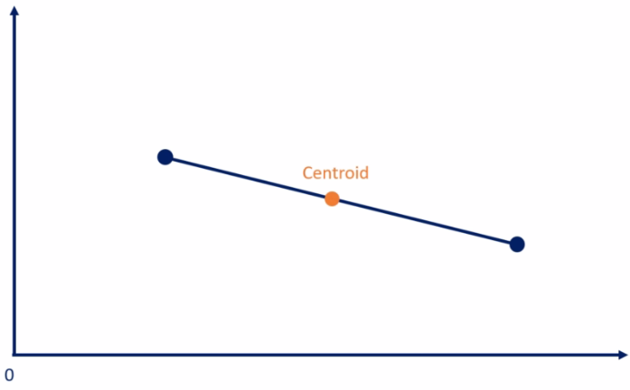
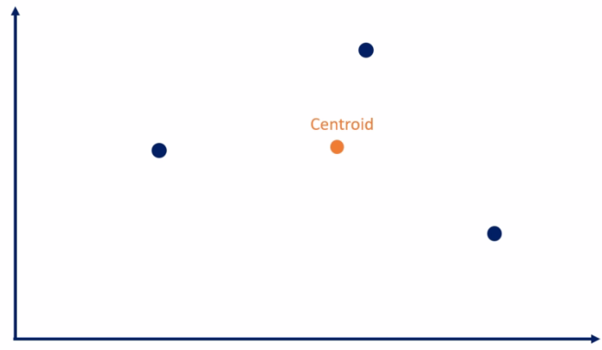
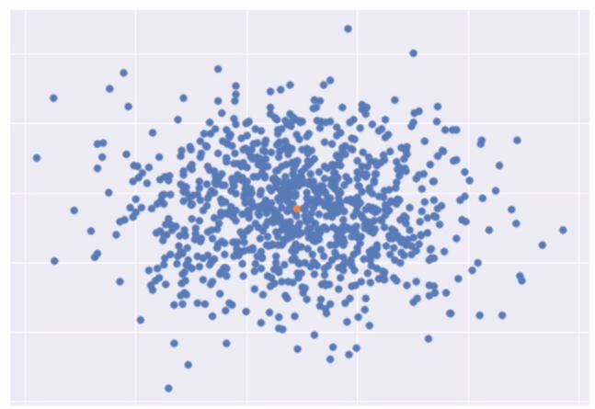
Pre-Requisite Concepts
Some Pre-requisite concepts:
Distance between points
Centroid
Lets see what Centroid is ?
Centroid is the mean position of a group of points (aka center of mass)

Slide 17
K-Means Clustering

Slide 18
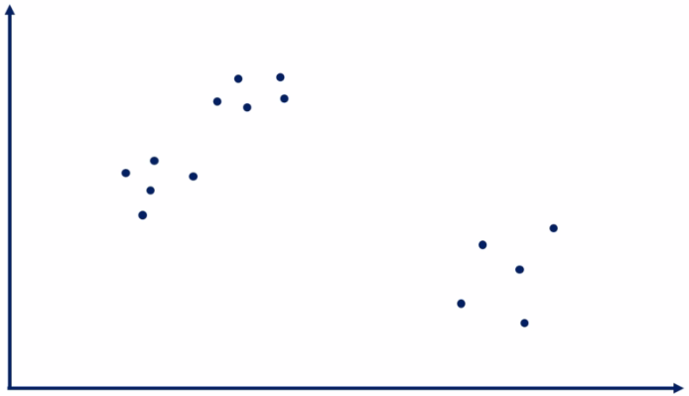
K-Means – How it works
Lets start with an example:
Lets say we have 15 observations across two features.
This is how we plot them:

Slide 19
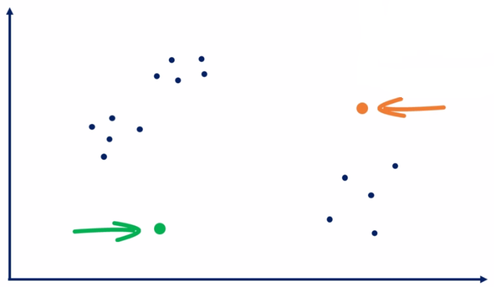
K-Means – How it works
Step 1: Choose the number of clusters
We must choose how many number of cluster we would like to have.
That’s what the ‘K’ stands for in ‘K-Means’
Say we choose k=2
Step 2: Specify the cluster seed (initial centroid/s)
A seed is basically a starting centroid.
A seed is chosen at random, or specified by someone who has a prior knowledge about the data

Slide 20
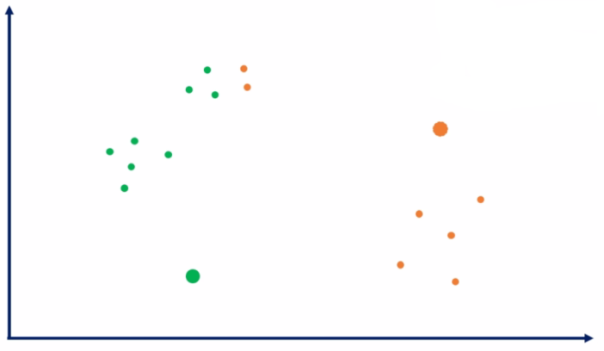
K-Means – How it works
Step 3: Assign each point to a centroid (seed)
This is done based on proximity.
The points closer to green seed will be assigned as green, while the points closer to orange seed will be assigned as orange.
Here we use Euclidean formula to find the distance.

Slide 21
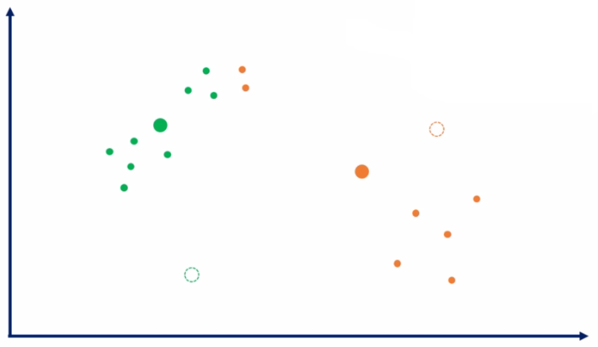
K-Means – How it works
Step 4: Adjust the centroids
The final step to calculate the centroid of the green and orange points.
Here,
Basically we re-adjust the centroid. i.e. we calculate the mean distance from all the similar (green and orange) points and move the centroid to that mean location.

Slide 22
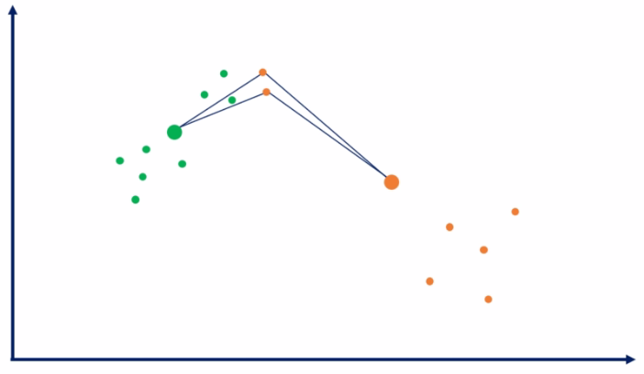
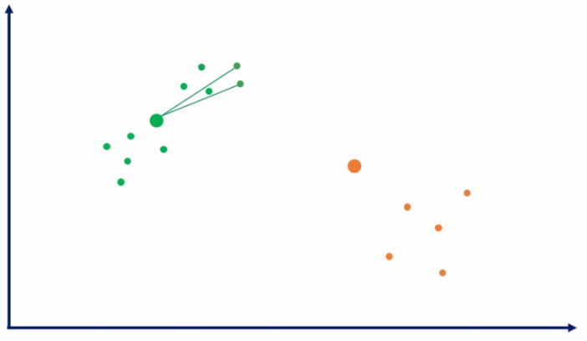
K-Means – How it works
Step 5: Repeat Step 3 and Step 4 Until no re-assignment of points are possible
Repeating Step 3: Now again, calculate the distance of each point from the new centroids and assign accordingly.
Here we recalculate the distance as shown below and assign the two orange points to green cluster as a part of this step.

Slide 23
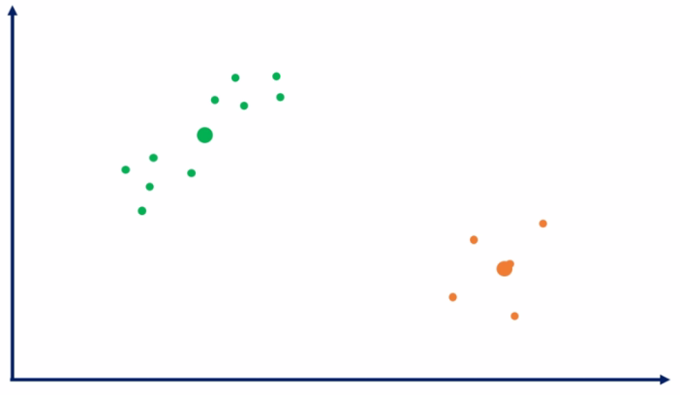
K-Means – How it works
Step 5: Repeat Step 3 and Step 4
Repeating Step 4: Calculate the centroids again.
New Centroid points are
We repeat these steps until all the green points are closest to green centroid and all the orange points are closes to the orange centroid and we can no longer re-assign points, and that completes the clustering process.

Slide 24
K-Means – Pros & Cons
Pros:
Simple to understand
Fast to cluster
Widely available (lots of packages available)
Easy to implement
Always yields result (also a Con, It may be deceiving as well)

Slide 25
K-Means – Pros & Cons
Cons:
We need to pick ‘K’
Sensitive to initialization. If seeds are initialized not properly, then the datapoints will be clustered in a non expected way.
Sensitive to outliers (Because of Euclidean the outliers are always classified in their own cluster. i.e. If a point is far away, K means will classify it as another cluster rather than outlier.
Standardization
Remedies:
Remedy for 1st Con: The elbow method
Remedy for 2nd Con: k-means ++ (sklearn implements this by default). The idea is to run an iterative algorithm in advance before clustering to find good values for initial seeds.
Remedy for 3rd Con: Remove Outliers

Slide 26
K-Means – Standardization
Should we standardize the variables ?
Well it depends,
It is recommended to standardize the variables.
However, If we know that our one variable is inherently important than the other, then we do not standardize.
There is no fixed rule of standardization in K-Means as we had in other algorithms.
It all comes with experience and the knowledge of the data.

